Slide 1
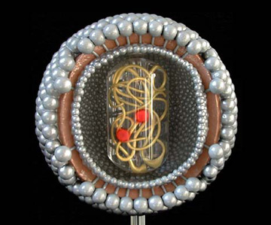
What is Human Immunodeficiency Virus (HIV)?
HIV is is caused by HIV-1
This virus attacks the blood cells that maintain your immune system healthy.
AIDS is the most severe form of HIV infection. HIV infection is considered to be AIDS when at least one serious complicating illness develops or the number (count) of CD4⁺ lymphocytes decreases substantially.
HIV has mainly been transmitted through male homosexual contact (53%-2006); however, heterosexual incidences comprise 31% (2006) of cases in the USA.
In the United States, about 30% of adults who have HIV infection are women

Slide 2
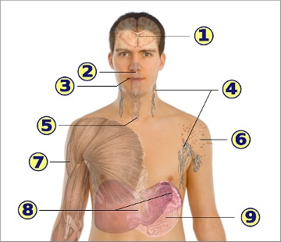
Symptoms and/or manifestations of HIV
Feeling sick, headache, neuropathy
Sore throat
Swollen glands
Sores and oral yeast infection
Sores
Skin rashes
Muscle pain
Liver and Spleen enlargement
Nausea and vomiting

